Slide 1
School Management System
Futureminds

Slide 2
The School Management System

Slide 3
Why You Need a School Management System
Today, information and communications technologies (ICTs) infiltrate classrooms around the world at an exceedingly rapid pace. 21st century students (millennials), as well as teachers and parents are practiced users of digital technology.
Reduces the time spent on day-to-day administrative tasks and increases the time spent on strategic tasks will improve the quality of teaching.
Provides systematic way of enhancing the teaching staff work efficiency
Streamline the educational process
Instantaneous availability of data

Slide 4
Why You Need a School Management System
To strengthen the relationship between parents and teachers
To easily track student progress
To save man hours and to reduce communication cost
To decrease the paperwork to a greater extent making the process cost effective
To Increase the productivity and efficiency of the office/management staff

Slide 5
What is FutureMinds
Futuremind is an open source school management system that utilizes the latest technologies to effectively and efficiently manage daily activities within a school environment.
This application provides a platform to unite school authorities, teachers, students and parents, and to enhance the quality of education.
The School Authorities, the Teachers and the Parents could monitor the progress of the Students.
Through this system, the Parent – Teacher interaction is enhanced
Futureminds is a Web-enabled application that can be accessed from anywhere around the world.
Principal and the Management Team could monitor the progress of the Teachers within the School using Futureminds

Slide 6
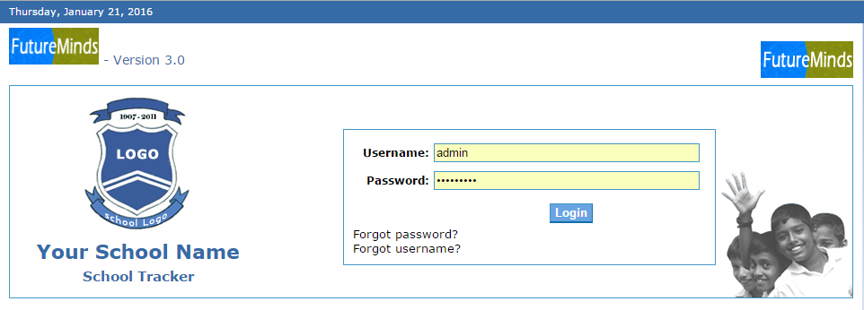
Login Page

Slide 7
Main Modules
Mainly Futuremind School Management System contains nine modules.
Student Module
Staff Module
Reference Module
School Module
Reporting Module
Attendance Module
User Mgt Module
Communication Module
Fee Module

Slide 8
How Far Does This Cover
Futureminds consists of the following basic functionalities:
Student Information Management (Students, Parents)
Staff Information Management (Teachers, Clerical Staff)
User Mgt/Authentication (Administrator, Teacher, Clerical Staff, Student)
Reports Generation
Document Management
Email and Short Message Services function
Attendance Management
Allocations Management
Notice board management
Student behavior management

Slide 9
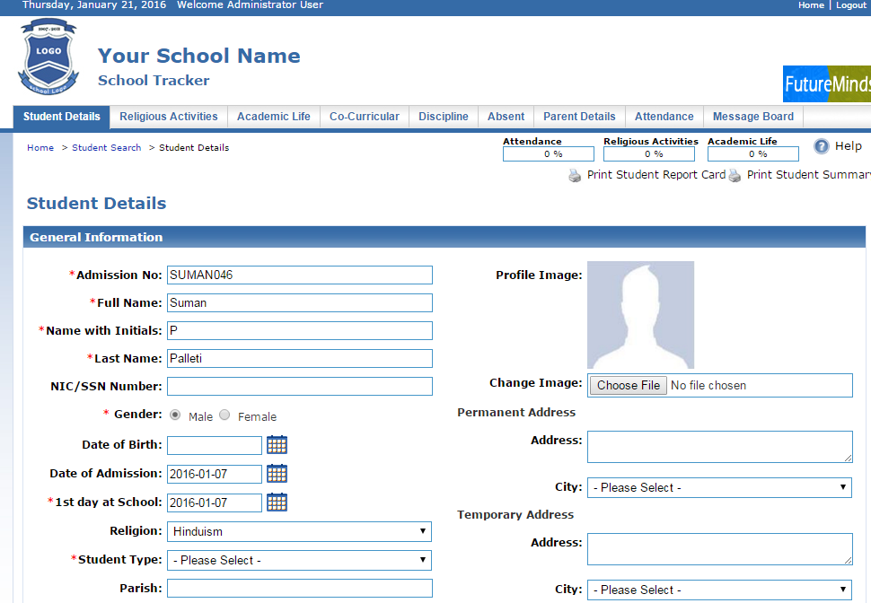
Student Module

Slide 10
Student Module
Maintain Attendance Details
Maintain Academic Details
Maintain Co-curricular Details
Maintain Parents’ Details
Maintain Religious
Activity Details
Maintain Disciplinary
Action Details

Slide 11
Staff Module
Maintain Attendance Details
Maintain Qualification Details
Maintain Class Allocation Details
Maintain Subject Allocation Details
Maintain Extra Curricular
Activity Details

Slide 12
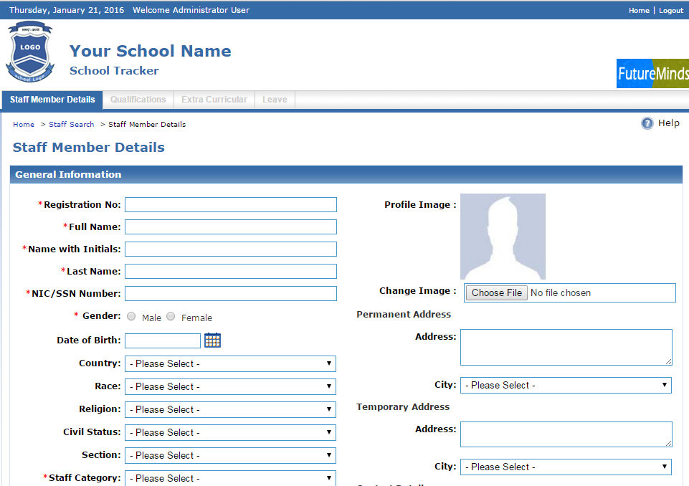
Staff Module

Slide 13
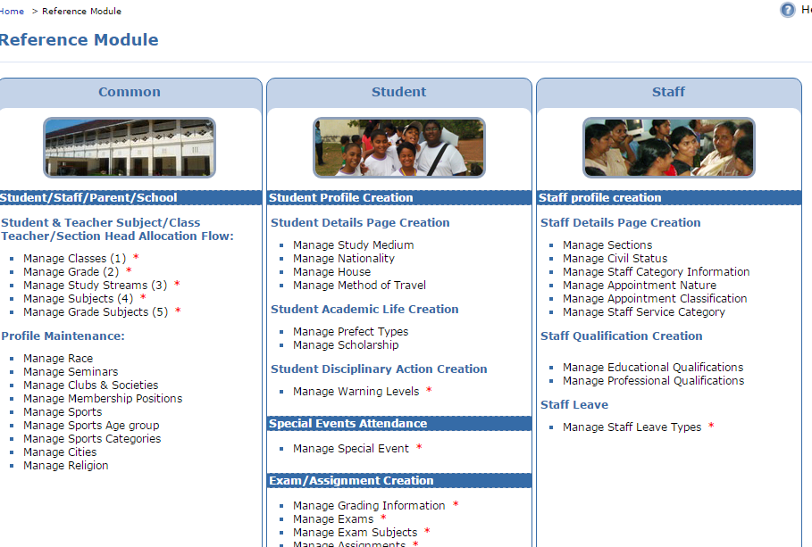
Reference Module

Slide 14
Reference Module
Maintain Master Data
Admin User can enter master data using above links

Slide 15
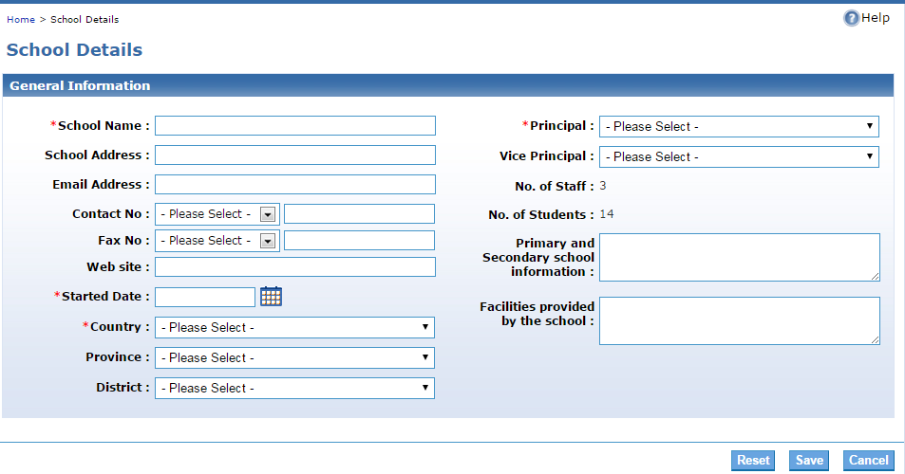
School Module
Maintain School Related Details

Slide 16
Reporting Module
Generate Reports on Student Attendance
Generate Reports on Staff Attendance
Generate Student General Reports
Generate Staff General Reports

Slide 17
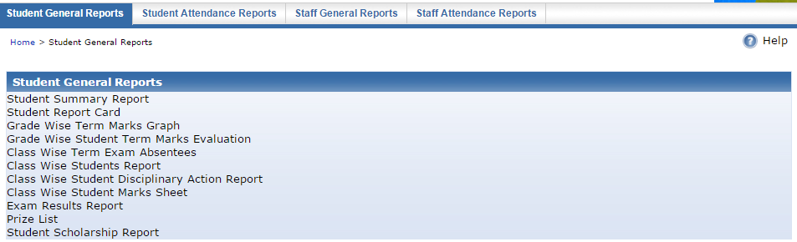
Reporting Module

Slide 18
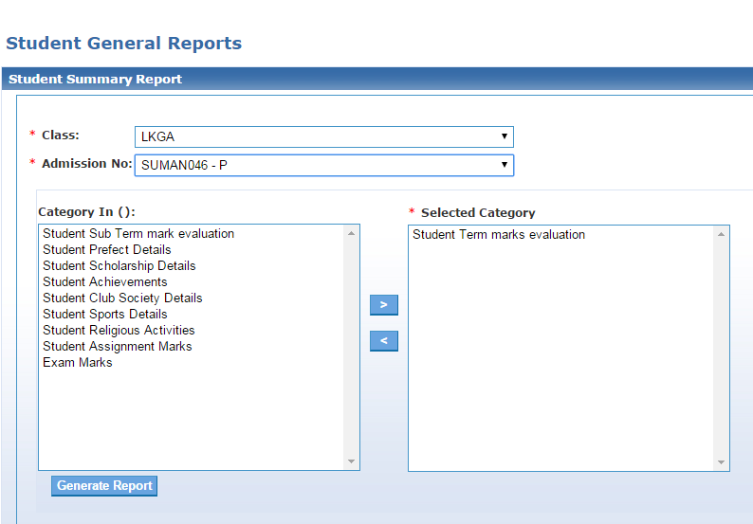
Reporting Module

Slide 19
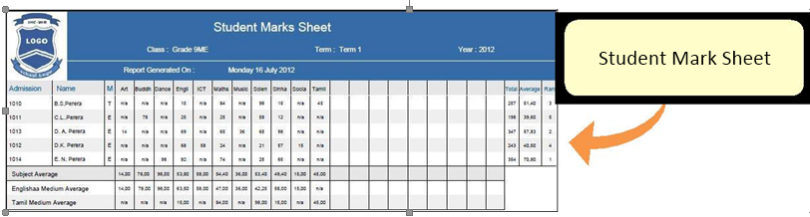
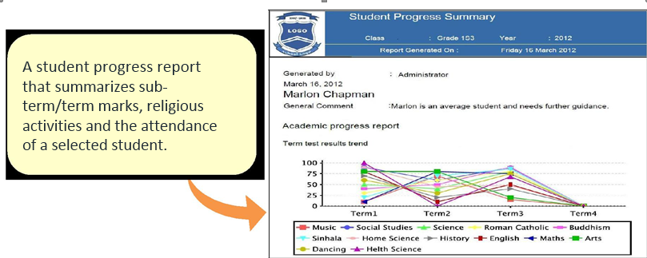
Sample Reports

Slide 20
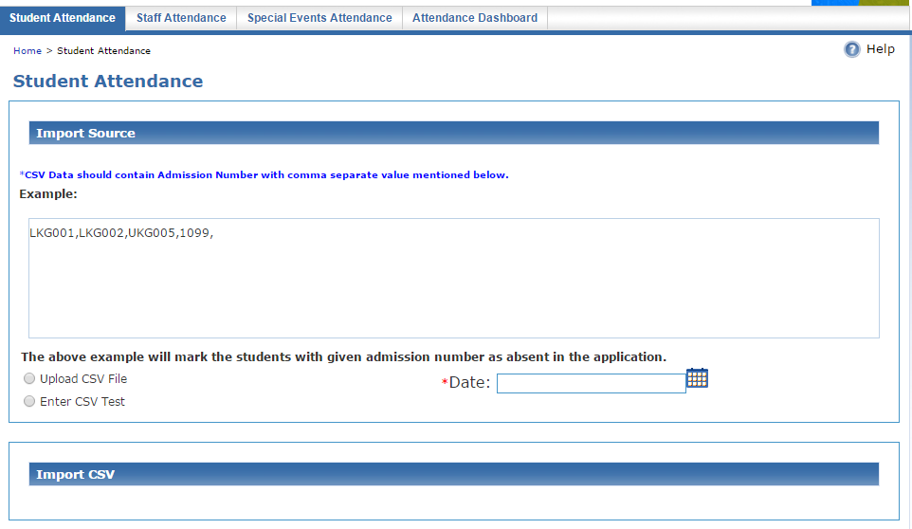
Attendance Module

Slide 21
Attendance Module
Maintain Student Attendance Details
Maintain Staff Attendance Details
Manually enter the staff attendance
Manually enter attendance for special events
Search best student attendance records by grade, class, month and year
Upload staff attendance data to the system

Slide 22
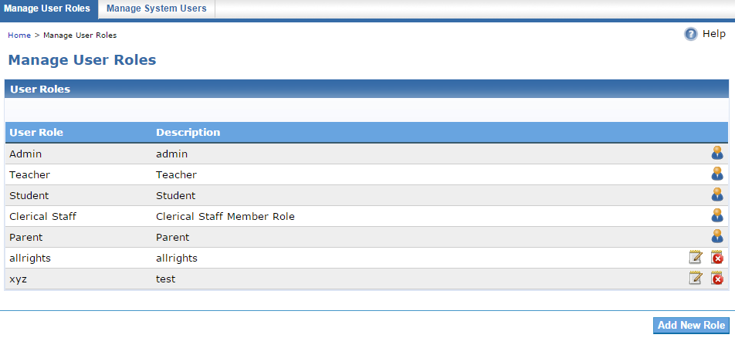
User Management Module

Slide 23
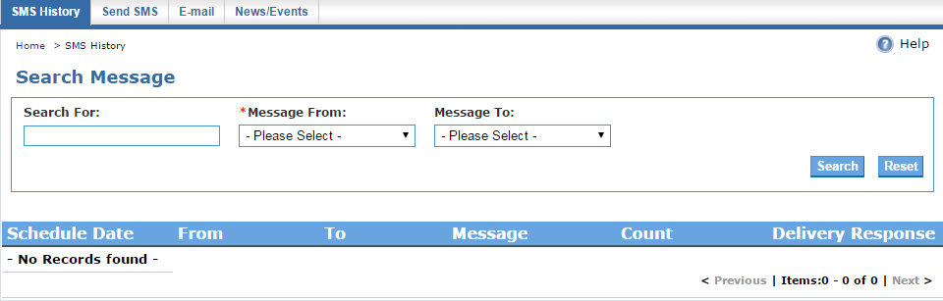
Communication Module
Send customized instant SMS messages to parents regarding quick updates.

Slide 24
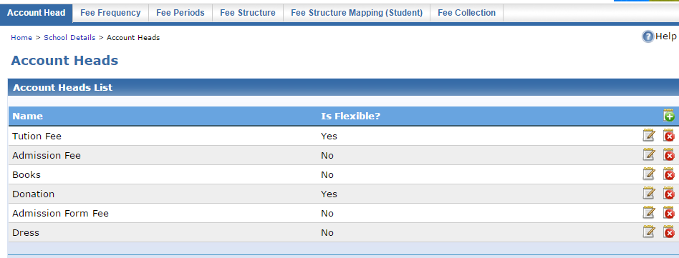
Fee Module

Slide 25
Benefits of using Futureminds
Futuremind helps the staff overcome issues with the manual system, making their documentation easier.
Futuremind improves the timeliness of the tasks.
Futuremind systemizes the entire school management process allowing users to store majority of their school's information electronically.
Futuremind contributes to the improvement of the students’ academic performances.
Futuremind helps to develop a better relationship between students, teachers and parents.
Futuremind provides fast access to relevant information.
Futuremind enables the school management to readily access information, view various reports and make managerial decisions.
Futuremind ensures the security of data.

Slide 26
Benefits of using Futureminds
Parents can view the below information on smartphones: o Student attendance details
Student marks (Term Marks, Exam Marks, Assignment Marks, Monthly Grades)
Any disciplinary action against the Student o Religious activities the Student has attended
Academic achievements of the Student
Parents can send instant messages to Teachers

Slide 27
Benefits of using Futureminds
Teachers can send instant messages to Parents for the below items:
School updates and events notifications
Attendance notifications of Students/Teachers
Notifications of classroom activities (specially for the Primary section)
Notifications of Student disciplinary actions
Notifications of Term marks and Assignment marks

Slide 28

Thanks
Thanks
Futureminds Team!

